Slide 1
Learning & Development Enabling development, Impacting growth…
BIG-04
HADOOP – Module 02

Slide 2
Module outline
Hadoop
History of Hadoop
Distributed File System
What is Hadoop
Characteristics of Hadoop
RDBMS Vs Hadoop
Hadoop Generations
Components of Hadoop
HDFS Blocks and Replication
How Files Are Stored
HDFS Commands
Hadoop Daemons
Q & A

Slide 3
History of Hadoop
Oct 2003: Google File system paper published
Dec 2004: Jeffrey Dean & Sanjay Ghemawat from Google published MapReduce paper called “MapReduce: Simplified Data Processing on Large Clusters”
Jan 2006: Above MapReduce Paper inspired Doug cutting, a yahoo employee then to develop an open source implementation of MapReduce framework
Jan 2006: Hadoop subproject created as extension of Apache Nutch project,
created by Doug Cutting.
Apr 2006: Hadoop 0.1.0 released
May 2006: Yahoo deploys 300 machine Hadoop cluster
2008: Cloudera, one of the major distributor of Hadoop founded
Hadoop was named after Doug Cutting’s son’s toy elephant.

Slide 4
History of Hadoop(continued)
Apr 2007: Yahoo runs 2 clusters of 1,000 machines
Jul 2008: Hadoop wins TeraByte sort benchmark
(1st time a Java program won this competition)
Jun 2010: Yahoo 4,000 nodes/70 petabytes
Jun 2010: Facebook 2,300 clusters/40 petabytes
Dec 2011: Apache Hadoop release 1.0.0 available
2011: Hortonworks, another major Hadoop distributor founded
Oct 2013: Apache Hadoop release 2.2.0 (YARN)
Dec 2015: Apache Hadoop release 2.6.3 available
Feb 2016: Apache Hadoop release 2.6.4 available
Source: http://hadoop.apache.org/#News
https://en.wikipedia.org/wiki/Apache_Hadoop#Papers

Slide 5
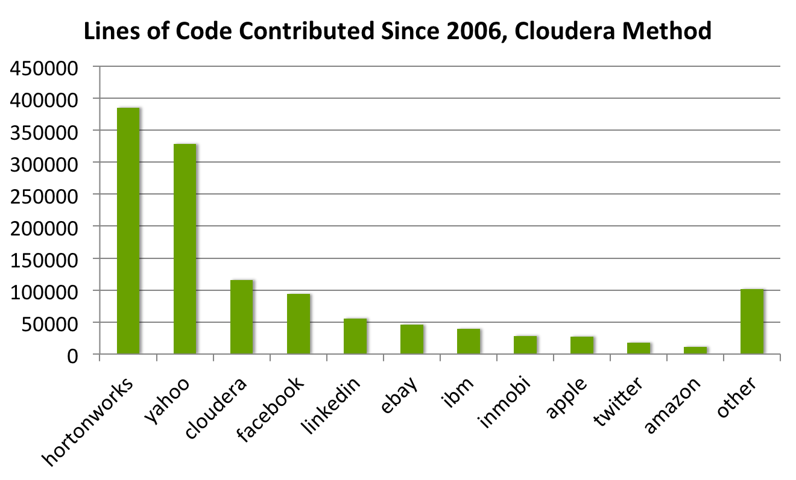
Contributions 2006 - 2011
(Source: . http://hortonworks.com/blog/reality-check-contributions-to-apache-hadoop/)

Slide 6
Quiz
1. Who was the creator of Hadoop?
Sanjay Ghemawat
Michael Franklin
Doug Cutting
Jeffrey Dean
2. What was Hadoop named after?
Creator’s favorite circus act
The toy elephant of creator’s son
Creator’s high school rock band
A sound Creator’s laptop made during Hadoop development

Slide 7
Quiz-Answers
1. Who was the creator of Hadoop?
Sanjay Ghemawat
Michael Franklin
Doug Cutting
Jeffrey Dean
2. What was Hadoop named after?
Creator’s favorite circus act
The toy elephant of creator’s son
Creator’s high school rock band
A sound Creator’s laptop made during Hadoop development
C: Doug Cutting
B: The toy elephant

Slide 8

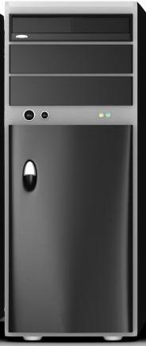
Distributed File System (DFS)
Read 1 TB Data
1 Machine 10 Machines
50 Minutes 5 Minutes

Slide 9

What is Hadoop
Hadoop is not a :
Database
Big Data
Networking Concept
Data warehouse
Programming Language
Then What Hadoop is.......??

Slide 10
What is Hadoop(continued)
Hadoop is a framework that allows distributed processing of large data sets across clusters of commodity computers using simple programming models.
Definition In Depth:
Distributed Processing :
Data is processed in multiple machines in a distributed manner
Large Data sets:
Large data sets in this context means files that are hundreds of megabytes, gigabytes, or terabytes in size
Clusters of commodity computers :
Cheap hardware (not expensive servers) are used to create a cluster
Simple Programming Model:
Map Reduce/Spark is used as a programming model to manipulate/process the data

Slide 11
Characteristics of Hadoop
Scalable: It can reliably store and process petabytes of data and can be scaled up anytime whenever required without any adverse impact of cluster.
Economical: It distributes the data and processing across clusters of commonly available computers (in thousands).
Efficient: By distributing the data, it can process it in parallel on the nodes where the data is located.
Reliable: It automatically maintains multiple copies of data and automatically redeploys computing tasks based on failures.
Notes:
These are the features making Hadoop among different organizations in various sectors.

Slide 12



Relational DB vs. Hadoop
Uses commodity PCs
Built for extreme scalability
Designed for extreme volumes (10s of PB and more)
Very high availability (clouds like Amazon distributed all around the world)
Initially developed by Google for storing Petabytes of web pages for ranking
Not yet fully mature
Hadoop = Data is distributed over many machines
MapReduce = Computing is distributed and executed where data is (grid solution)
Works on Write Once read many times approach
Expensive dedicated HW
Built for performance
Designed for high volumes (eg 10s of TB)
High availability
Initially developed using Relational Data bases
Supports only modelled and structured data
Business As Usual ways to design, build and deliver
Very mature solutions (skills, SW, HW, administration)
Teradata, Oracle Exadata, IBM Netezza, ...

Slide 13
Generations of Hadoop
Hadoop
Hadoop 1.X
Hadoop 2.X
Notes:
Hadoop 1.x is tested up to 4000 nodes cluster and Hadoop 2.x beyond that.

Slide 14
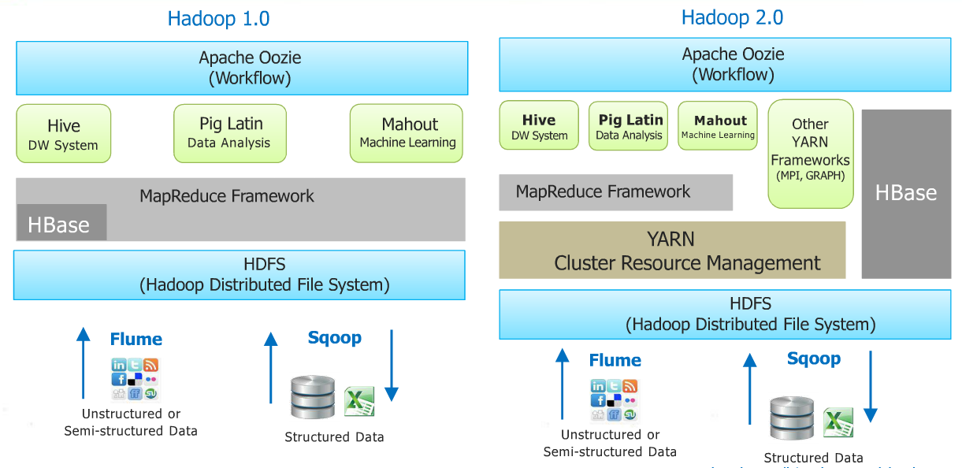
Hadoop Ecosystem

Slide 15
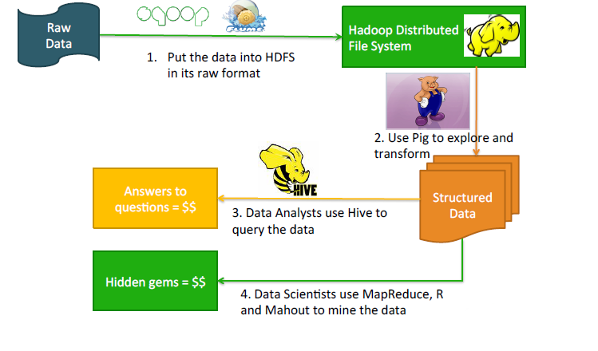
Usage of Hadoop and its eco-systems

Slide 16

Components of Hadoop
Hadoop is a platform for data storage and processing that is…
Scalable
Fault tolerant
Open source
CORE HADOOP COMPONENTS
Hadoop Distributed File System (HDFS)
File Sharing & Data Protection Across Physical Servers
MapReduce
Distributed Computing Across Physical Servers

Slide 17
Components of Hadoop(continued)
Two core components of Hadoop :
Hadoop Distributed File System (HDFS)
Map Reduce
HDFS :
Is the storage part of Hadoop framework
Data is stored in files under directories
Files are always divided into blocks
Map Reduce :
Is the programming/processing model of Hadoop framework
Is responsible for manipulation or processing on data
Preferebly written as java programs

Slide 18
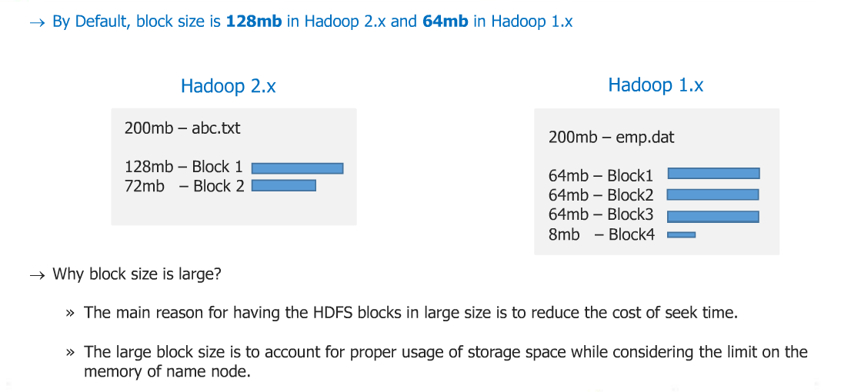
HDFS Blocks & Replication
Data files are divided into blocks and distributed across multiple nodes in the cluster
Each block is typically multiple of 64 MB in size in Hadoop 1.X and 128 MB in Hadoop 2.X
Notes:
Earlier too, data was stored in distributed way in multiple servers/machines. But These machines were high configuration servers/machines. And no replication on any data was performed. Systems may have different topologies like star, mesh etc.
Eg: If a file of 100 MB is stored in a distributed manner in 5 machines i.e. each machine has 20 MB data. If any of the machine fails, there was no way to recover that. It has been overcome in Hadoop by replicating the data blocks in different machine and hence hadoop has better fault tolerance mechanism.

Slide 19
HDFS Blocks & Replication(continued)
Each block is replicated multiple times
Default replication factor is 3 (configurable)
Replicas are stored on different nodes
This ensures both reliability and availability
Blocks Replicated Blocks
64 MB → 64 MB → 64 MB →
64 MB → 64 MB → 64 MB →
22 MB → 22 MB → 22 MB →
Considered Hadoop 1.X in above example.
Block_1
Block_1’
Block_1’’
abc.txt
150 MB
Block_2
Block_2’
Block_2’’
Block_3
Block_3’
Block_3’’

Slide 20
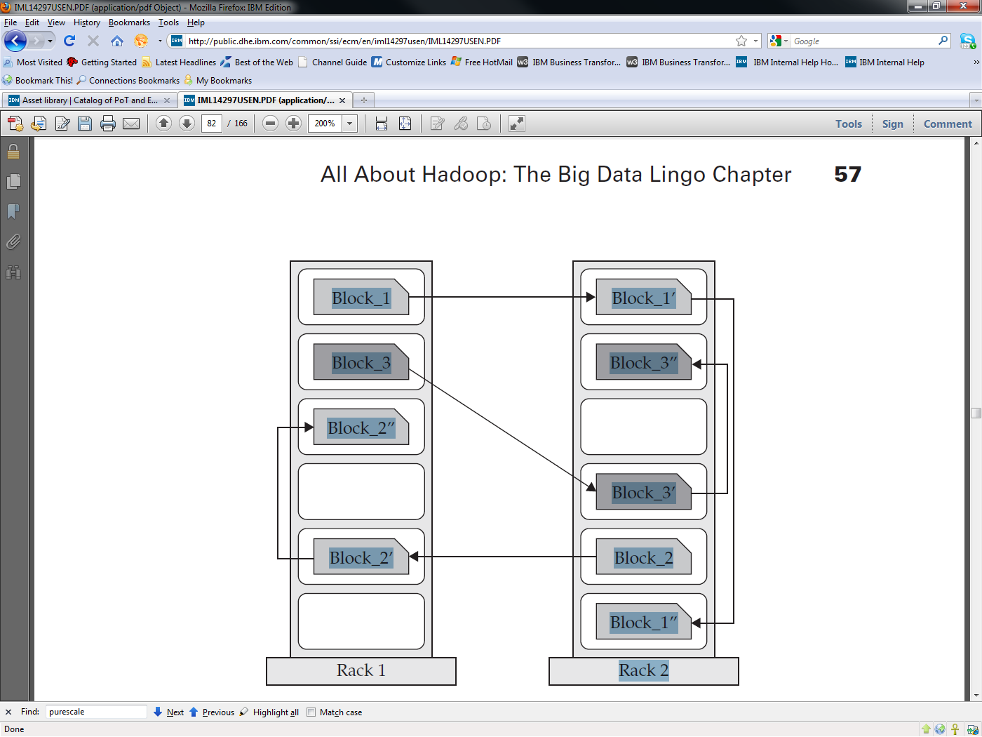
Rack Awareness
Notes:
Block_1 will be stored in a data node of rack 1 and its replicated blocks Block_1’ and Block_1’’ will be in rack 2. This is done to overcome rack failure.
It will never happen that Block_1 and its any replicated blocks are stored in same rack.

Slide 21
How Files Are Stored
Files are split into blocks
Data is distributed across many machines at load time
Different blocks from the same file will be stored on different machines
This provides for efficient MapReduce processing.
Blocks are replicated across multiple machines, known as Data Nodes
Default replication is three-fold meaning that each block exists on three different machines
A master node called the Name Node keeps track of which blocks make up a file, and where those blocks are located
Known as the metadata

Slide 22
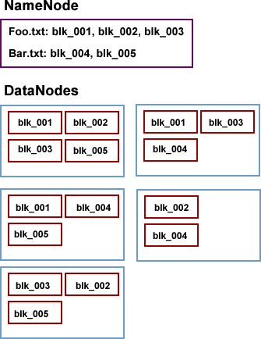
How Files Are Stored: Example
Name Node holds metadata for the two files (Foo.txt and Bar.txt)
Data Nodes hold the actual blocks
Each block will be 64 MB or 128 MB in size
Each block is replicated three times on the cluster

Slide 23
Fault Tolerance in Hadoop
If a data node fails, the master(Name Node) will detect that failure and re-assign the task to a different node on the cluster
Restarting a task does not require communication with nodes working on other portions of the data
If a failed node recovers, it is automatically added back to the cluster and assigned new tasks
If a node appears to be running slowly, the master can redundantly execute another instance of the same task
Results from the first to finish will be used
Known as ‘speculative execution’
Data is distributed across many machines at load time
Different blocks from the same file will be stored on different machines
This provides for efficient MapReduce processing.
Blocks are replicated across multiple machines, known as Data Nodes
Default replication is three-fold meaning that each block exists on three different machines
A master node called the Name Node keeps track of which blocks make up a file, and where those blocks are located
Known as the metadata

Slide 24
Quiz
1. What is Hadoop?
Database
Framework
Programming Language
File
2. What is a Hadoop cluster?
Group of machines connected in a network
Group of machines sharing same software
Group of connected machines running HDFS & Map Reduce
Group of machines sharing same printer

Slide 25
Quiz-Answers
1. What is Hadoop?
Database
Framework
Programming Language
File
2. What is a Hadoop cluster?
Group of machines connected in a network
Group of machines sharing same software
Group of connected machines running HDFS & Map Reduce
Group of machines sharing same printer
B: Framework
C: Group of Machines
Running HDFS & MR

Slide 26
Quiz(continued)
3. Default block size in Hadoop 2.X is :
64 MB
68 MB
188 MB
128 MB
4. Data Blocks are stored in ?
Name Node
Data Node
Database
A&B

Slide 27
Quiz-Answers(continued)
3. Default block size in Hadoop 2.X is :
64 MB
68 MB
188 MB
128 MB
4. Data Blocks are stored in ?
Name Node
Data Node
Database
A&B
D: 128 MB
B: Data Node

Slide 28
Quiz(continued)
5. How many number of blocks will be created for a file xyz.txt of size 200 MB considering Hadoop 1.x environment?
4
5
2
3

Slide 29
Quiz-Answers(continued)
5. How many number of blocks will be created for a file xyz.txt of size 200 MB considering Hadoop 1.x environment?
4
5
2
3
A: 4

Slide 30
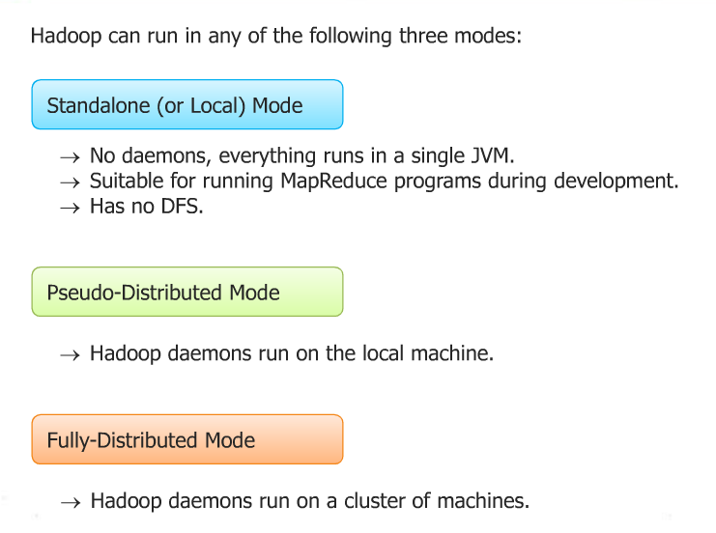
Hadoop Cluster Modes

Slide 31
HDFS Commands
HDFS Commands are used to
access Hadoop Distributed File System (HDFS)
list down files and directories present in HDFS
create and remove directory in HDFS
push the data present in landing zone(local machine) to HDFS
copy the data back to landing zone(local machine) from HDFS

Slide 32
HDFS Commands(continued)
Get a directory listing of the HDFS root directory
Create a directory called input under the user directory
Copy file foo.txt from local disk to the input directory in HDFS
hadoop fs –ls /
hadoop fs –mkdir /user/input
hadoop fs -copyFromLocal foo.txt /user/input/foo.txt

Slide 33
HDFS Commands(continued)
Display the contents of the HDFS file /user/input/foo.txt
Copy the file foo.txt from HDFS to local
Delete the file bar.txt in HDFS
hadoop fs –cat /user/input/foo.txt
hadoop fs –copyToLocal /user/input/foo.txt foo.txt
hadoop fs –rm /user/input/bar.txt

Slide 34
HDFS Commands(continued)
Delete the input directory in HDFS
→ -r used for recursive, deletes directory even if some file is present under that.
For more commands please refer:
http://hadoop.apache.org/docs/current/hadoop-project-dist/hadoop-common/FileSystemShell.html
hadoop fs –rm [–r ] /user/input/

Slide 35
Hadoop Daemons
Hadoop Works on Master-Slave pattern
There are 5 daemons in Hadoop 1.x
Name Node → Master Node
Secondary Name Node → Master Node
Job Tracker → Master Node
Task Tracker → Slave Node
Data Node → Slave Node

Slide 36
Hadoop Daemons(continued)
Name Node stores metadata of cluster
Block details
Replication details
Load Balancing
High configuration machine, 1 Name Node per cluster
Secondary Name Node is the backup of Name Node
Takes backup of Name Node in a regular interval
Not called as complete backup of Name Node
Job Tracker is the daemon where hadoop jobs are submitted
Task Tracker accomplish the task which are submitted to job tracker
Data Node is the daemon where actual data in the form of blocks reside

Slide 37
Hadoop Daemons(continued)
Name Node
Job Tracker
Name Node coordinates with Data Nodes
In turn, all Data Nodes send heart beats to Name Node periodically
Job Tracker coordinates with Task Tracker
Data Node
Task Tracker

Slide 38
Hadoop Daemons– Corporate Analogy
Manager is appointed who will govern the project.
Manager recruits 6 Members to Join the project team.
They all communicate with each other.
Manager interacts with each of the 6 Team members.
Each team member confirms his presence to the manger everyday
Manager distributes the work volume based on Team’s utilization.
Assistant manager is provisioned as a backup manager.
Manager updates the Assistant manager every day about activities done by each resource.
One day Manager goes on unplanned leave and based on the last update received, the asst. manager takes over the activities.
Manager
Assistant
Manager
Team
1
2
3
4
5
6

Slide 39
Hadoop Daemons(continued)
Manager : Name node
6 Team Members : 6 data Nodes.
Assistant manager : Secondary Name Node
All Nodes communicate via SSH password less protocol.
Each DataNode sends heartbeat signals to the Name node confirming they are live.
Name node distributes the data Blocks across Datanodes based on their memory utilization and alive status.
Secondary NameNode acts as a failover to avoid single point of failure.
Name Node
JT
Secondary
Name Node
When a MR program is submitted it goes to the Job Tracker(JT)
JT talks with NameNode to understand which Data Nodes have the required data blocks of the source files.
Once identified, JT talks to the TTs on those Nodes and use them to perform the assigned Tasks.
On task completion, JT updates the NameNode on the new Block location where the output is stored.
HDFS
DN1
TT
TT
DN2
TT
DN3
TT
DN4
TT
DN5
TT
DN6

Slide 40
Quiz
1. Which of the below HDFS command is used to create a directory in hdfs
hadoop fs -dir /user/abc
hadoop fs -crdir /user/abc
hadoop fs -mkdir /user/abc
Hadoop fs -mdir /user/abc
2. Which of the below HDFS command is used to copy file from local to HDFS?
hadoop fs -copy 1.txt /user/abc/1.txt
hadoop fs -copyfromlocal 1.txt /user/abc/1.txt
hadoop fs -copyFromLocal 1.txt /user/abc/1.txt
Hadoop fs -CopyToLocal 1.txt /user/abc/1.txt

Slide 41
Quiz-Answers(continued)
1. Which of the below HDFS command is used to create a directory in hdfs
hadoop fs -dir /user/abc
hadoop fs -crdir /user/abc
hadoop fs -mkdir /user/abc
Hadoop fs -mdir /user/abc
2. Which of the below HDFS command is used to copy file from local to HDFS?
hadoop fs -copy 1.txt /user/abc/1.txt
hadoop fs -copyfromlocal 1.txt /user/abc/1.txt
hadoop fs -copyFromLocal 1.txt /user/abc/1.txt
Hadoop fs -CopyToLocal 1.txt /user/abc/1.txt
C: mkdir
C: copyFromLocal

Slide 42
Quiz
3. Which of the below HDFS command is incorrect?
hadoop fs -copytolocal /user/abc/1.txt 1.txt
hadoop fs -mkdir /user/abc
hadoop fs -ls /user/abc/
Hadoop fs -cat /user/abc.txt
4. Name Node stores ______ of cluster :
Actual data
Blocks
Metadata
Replicated blocks

Slide 43
Quiz-Answers(continued)
3. Which of the below HDFS command is incorrect?
hadoop fs -copytolocal /user/abc/1.txt 1.txt
hadoop fs -mkdir /user/abc
hadoop fs -ls /user/abc/
Hadoop fs -cat /user/abc.txt
4. Name Node stores ______ of cluster :
Actual data
Blocks
Metadata
Replicated blocks
A:
Reason: copyToLocal
Command is case sensitive
C: Metadata

Slide 44
Quiz
5. Secondary Name Node is complete Backup of Name Node?
True
False
6. Which of the following are Master Nodes?
Name Node and Data Node
Name Node and Job Tracker
Secondary Name Node
Both A & C
Both B & C

Slide 45
Quiz-Answers(continued)
5. Secondary Name Node is complete Backup of Name Node?
True
False
6. Which of the following are Master Nodes?
Name Node and Data Node
Name Node and Job Tracker
Secondary Name Node
Both A & C
Both B & C
B: False
It takes backup in regular
intervals only.
E: Both B & C

Slide 46
Final Quiz
1. Hadoop is a framework that works with a variety of related tools. Common cohorts include:
MapReduce, Hive and HBase
MapReduce, MySQL and Google Apps
MapReduce, Hummer and Iguana
MapReduce, Heron and Trumpet
2. What technology might you use to stream Twitter feeds into Hadoop?
Sqoop
Flume
Pig
Hive

Slide 47
Final Quiz-Answers
1. Hadoop is a framework that works with a variety of related tools. Common cohorts include:
MapReduce, Hive and HBase
MapReduce, MySQL and Google Apps
MapReduce, Hummer and Iguana
MapReduce, Heron and Trumpet
2. What technology might you use to stream Twitter feeds into Hadoop?
Sqoop
Flume
Pig
Hive
A: MR ,Hive & HBase
B: Flume

Slide 48
Q & A

Slide 49
Thank You

